Slide 1

Note: The data and information in this document is reflective of a hypothetical situation and client. This document is to be used for KPMG Virtual Internship purposes only.
Sprocket Central Pty Ltd
Data analytics approach
[Division Name] - [Engagement Manager], [Senior Consultant], [Junior Consultant]

Slide 2
Note: The data and information in this document is reflective of a hypothetical situation and client. This document is to be used for KPMG Virtual Internship purposes only.
Agenda
Introduction
Data Exploration
Model Development
Interpretation

Slide 3
Note: The data and information in this document is reflective of a hypothetical situation and client. This document is to be used for KPMG Virtual Internship purposes only.
Introduction
Presentation is divided into 5 parts:
Customer’s Age Distribution.
Bike purchases in past 3 years.
Job Industry Categorization.
Wealth Segments
No. of Cars Owned

Slide 4
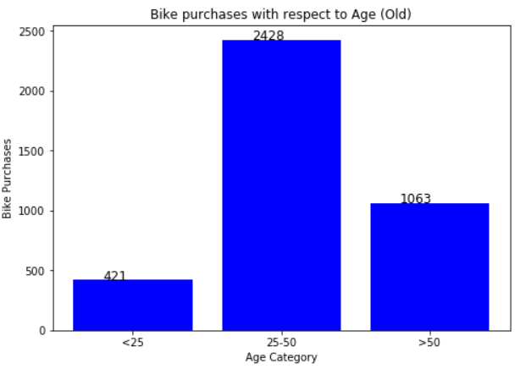
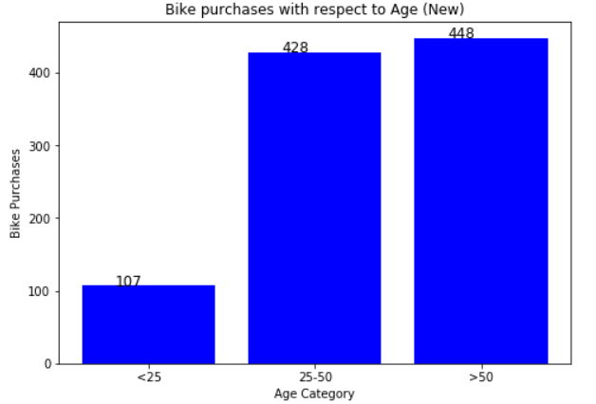
Note: The data and information in this document is reflective of a hypothetical situation and client. This document is to be used for KPMG Virtual Internship purposes only.
Data Exploration
Customer’s Age Distribution
Most of the customers are between 25 to 48 years old.
Percentage of customers from 25 to 50 years old has increased.
Number of customers above 50 years old has big drops on percentages.
The percentages of under 25 years old has not really changed.

Slide 5
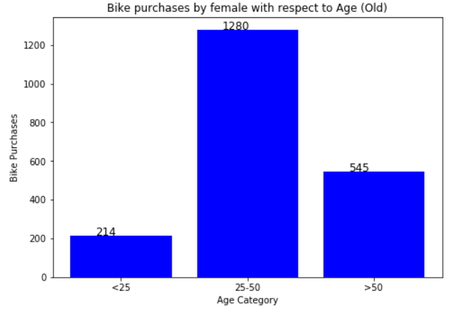
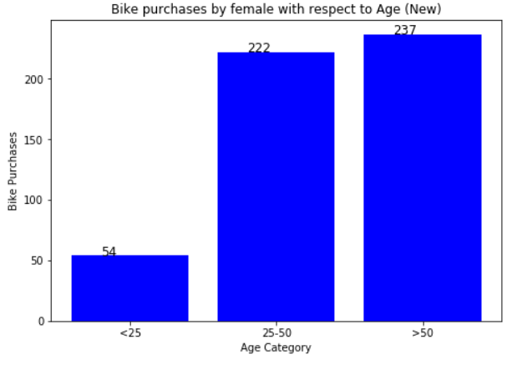
Data Exploration
Female Age Distribution

Slide 6

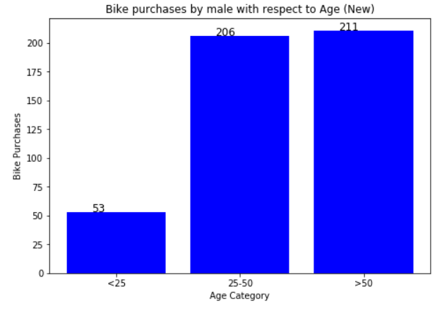
Data Exploration
Male Age Distribution

Slide 7
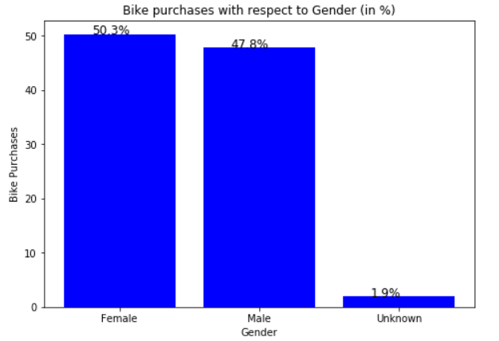
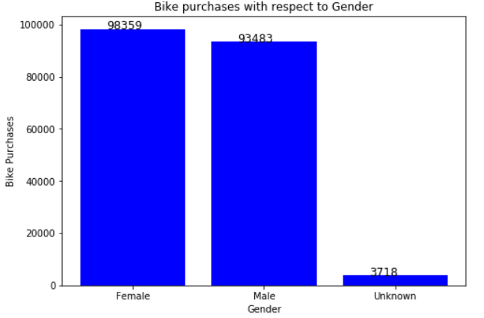
Note: The data and information in this document is reflective of a hypothetical situation and client. This document is to be used for KPMG Virtual Internship purposes only.
Model Development
Bike Purchases in Last 3 Years
Female contributed with 50.3% purchases with total of 98,365 bikes.
Male contributed with 47.8% purchases with total of 93,483 bikes.
Focus should be on Female Purchasers.

Slide 8
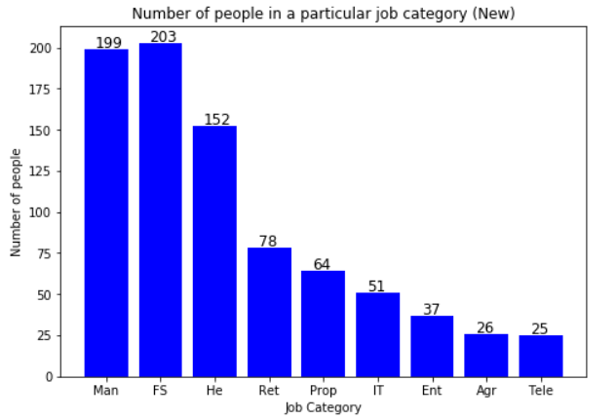
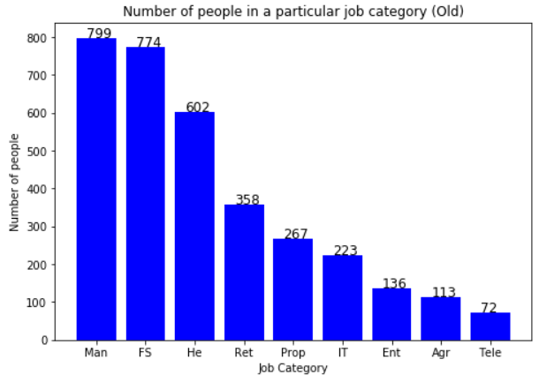
Note: The data and information in this document is reflective of a hypothetical situation and client. This document is to be used for KPMG Virtual Internship purposes only.
Interpretation
Job Categorization
Most customers are from Financial Services category.
There is some increase in number of customers in Manufacturing Category.
Customers in other categories remain same.
Man: Manufacturing FS: Financial Services He: Health Ret: Retail Prop: Property Ent: Entertainment Agr: Agriculture Tele: Telecommunication

Slide 9
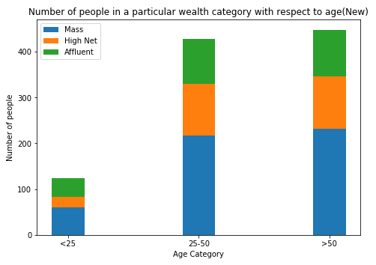
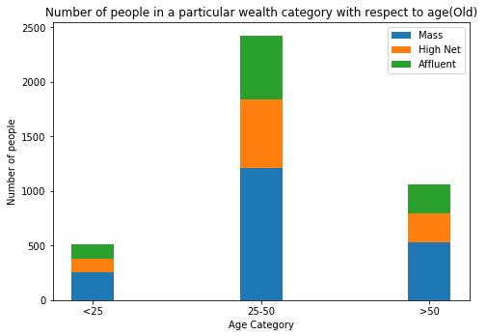
Note: The data and information in this document is reflective of a hypothetical situation and client. This document is to be used for KPMG Virtual Internship purposes only.
Interpretation
Wealth Segmentation
In all age categories, the number of Mass Customers is the highest.
Focus should be on Mass Customer and then High Net Customer.
Affluent Customers are less in <25 years as compared to other categories.

Slide 10
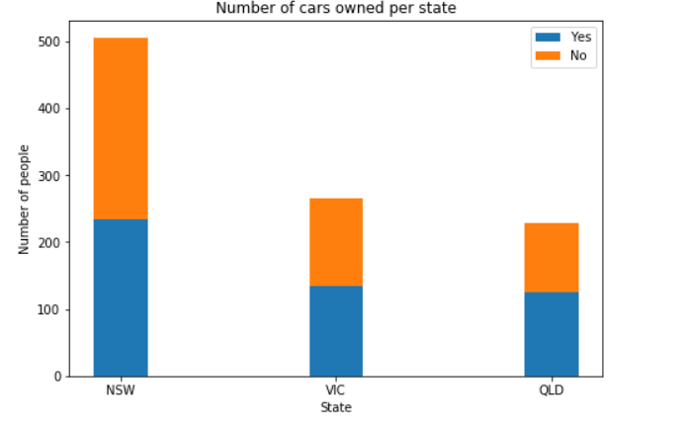
Interpretation
NSW should be considered the most since numbers of customers who don’t own cars is significantly larger than that own cars.
VIC and QLD have more customers that own car, so bike sales will be less in these states

Slide 11
Note: The data and information in this document is reflective of a hypothetical situation and client. This document is to be used for KPMG Virtual Internship purposes only.
Appendix

Slide 12
Note: The data and information in this document is reflective of a hypothetical situation and client. This document is to be used for KPMG Virtual Internship purposes only.
Appendix
THANK YOU

